Slide 1
DIGGS Schema Extensions: Geophysical Surveys (Phase 2)

Slide 2
Objective 1
Finalize result property dictionary for processed data
<results> <ResultSet> <parameters> <PropertyParameters gml:id="ampp"> <properties> <Property index="1" gml:id="p1"> <propertyName>residual magnetic field</propertyName> <typeData>double</typeData> <propertyClass codeSpace="DIGGS">magnetic_field_intensity_residual</propertyClass> <uom>nT</uom> </Property> </properties> </PropertyParameters> </parameters> <dataValues> -129. 129.1 -128.967 `128.813 -128.639 -128.443 -128.226 -127.991 -127.746 -127.496 -127.247 -127 -126.756 -126.517 -126.287 -126.069 -125.868 -125.685 -125.518 -125.362 -125.219 -125.093 -124.993 -124.927 </dataValues> </ResultSet> </results>

Slide 3
Code | Name | Description | Data type | UOMType
acoustic_impedance | acoustic impedence | acoustic flow resistance within a given medium | double | product of density and velocity
bulk_density | density, bulk (natural) | Total mass (of solids and water) divided by total volume of material, representing natural conditions | double | mass per volume
modulus_bulk | bulk modulus | Bulk modulus, denoted by K or B, is defined as a measure of how resistant to compression the substance is. | double | pressure
capacitance | capacitance | The measured capacitance which is the ratio of delta charge and delta potential | double | dimensionless
compressional_slowness | compressional slowness | The time it takes for a compressional wave to traverse a fixed distance; reciprocal of Compressional_Velocity. | double | time per length
conductivity | electrical conductivity | A measure of the conductive power of a specified material to the flow of an electric current. | double | electric conductivity
dielectric_constant | dielectric constant | The ratio of the permittivity of the medium to the permittivity of the free space | double | dimensionless
em_velocity | electromagnetic velocity | The velocity of electromagnetic wave propagation through a medium | double | length per time
flow_velocity | Flow velocity | direction and rate of vertical flow velocity within the borehole | double | length per time
gamma_ray | gamma ray | The intensity of natural gamma-ray radiation emitted from formations containing radioactive elements, such as Potassium, Thorium, and Uranium. Measured according to API specifications or as counts per time | double | api gravity
gravity_relative | relative gravitational field strength | acceleration due to gravity in relative terms | double | linear acceleration
gravity_absolute | absolute gravitational field strength | acceleration due to gravity in absolute terms | double | linear acceleration
magnetic_field_total | total field strength | Strength of the magnetic field | double | electric current per length
magnetic_field_x | x component of magnetic field strength | The x component of a magnetic field | double | electric current per length
magnetic_field_y | y component of magnetic field strength | The y component of a magnetic field | double | electric current per length
magnetic_field_z | z component of magnetic field strength | The z component of a magnetic field | double | electric current per length
magnetic_susceptibility | magnetic susceptibility | The magnetic susceptibility of a given medium | double | dimensionless
modulus_young | young's modulus | The tangent modulus of the initial, linear portion of a stress-strain curve for material in axial compression or tension is called Young's modulus, also known as the tensile (compression) modulus. It is defined as the ratio of the uniaxial stress over the uniaxial strain in the range of stress in which Hooke's Law holds. It is often calculated using theory of elasticity from other tests. | double | pressure
p_wave_velocity | primary compression wave velocity | P waves (primary waves) are compressional waves that are longitudinal in nature. | double | length per time
poisson_ratio | poisson ratio | Ratio of the transverse contraction of a body to its longitudinal extension when stretched. Typical values in minerals are from 0.15 to 0.3 (Carbonates:0.15, Sandstones:0.2, Shales:0.25). | double | dimensionless
potential_electrical | electrical potential | electric potential of the system | double | electric potential difference
relaxation_time_constant | relaxation time constant | relaxation time constant | double | dimensionless
resistivity | electrical resistivity | A measure of the resisting power of a specified material to the flow of an electric current. | double | electrical resistivity
modulus_shear | shear modulus | Shear modulus, denoted by G, is defined as the ratio of shear stress to the shear strain. | double | pressure
shear_slowness | shear slowness | Acoustic slowness of a shear wave (Vs); reciprocal of Shear_Velocity; a shear wave is a type of seismic wave in which the particle motion is perpendicular to the direction of propagation; also called S-wave or secondary wave. | double | time per length
shear_velocity | shear velocity | The velocity of a shear wave (Vs); a shear wave is a type of seismic wave in which the particle motion is perpendicular to the direction of propagation in a horizontal plane ; also called S-wave or secondary wave. | double | length per time
sonic_porosity | sonic porosity | Sonic porosity | double | volume per volume
spontaneous_potential | spontaneous potential | Also called self potential, is a naturally occurring electric potential difference in the Earth, measured by an electrode relative to a fixed reference electrode. Spontaneous potentials are usually caused by charge separation in clay or other minerals, due to presence of semi-permeable interface impeding the diffusion of ions through the pore space of rocks, or by natural flow of a conducting fluid through the rocks. | double | electric potential difference
temperature | temperature | Measured temperature | double | thermodynamic temperature
tension | tension | The force tending to cause extension of a body, as experienced in a cable, rope, string, etc. | double | force
resistance | resistance | resistance within the system | double | electrical resistance
borehole_diameter | diameter of borehole | diameter of the borehole | double | length
tube_wave_velocity | tube wave velocity | wave velocity that propagates along the steel-cased borehole | double | length per time
s_wave_velocity | shear wave velocity | velocity of s-waves through the medium | double | length per time
attenuation | attenuation | attenuation of mechanical or em wave during propagation | double | dimensionless
wall_image | borehole wall image [R,G,B] | color image of the borehole wall | double | dimensionless

Slide 4
Code | Geophysical Method
magnetic_susceptibility | borehole log
p_wave_velocity | borehole log
poisson_ratio | borehole log
s_wave_velocity | borehole log
potential_electrical | electrical resisitivity
resistivity | electrical resisitivity
resistivity_app | electrical resisitivity
conductivity | frequency domain EM (FDEM)
in_phase_x | frequency domain EM (FDEM)
in_phase_y | frequency domain EM (FDEM)
quadrature_x | frequency domain EM (FDEM)
quadrature_y | frequency domain EM (FDEM)
resistivity | frequency domain EM (FDEM)
anomaly_bouguer | gravity
anomaly_free_air | gravity
bulk_density | gravity
gravity_absolute | gravity
gravity_gradient | gravity
gravity_relative | gravity
conductivity | ground penetrating radar (GPR)
dielectric_constant | ground penetrating radar (GPR)
dielectric_permittivity | ground penetrating radar (GPR)
em_velocity | ground penetrating radar (GPR)
capacitance | induced polarization (IP)
resistivity_app | induced polarization (IP)
electric_field_x | magneotellurics (MT)
electric_field_y | magneotellurics (MT)
magnetic_field_x | magneotellurics (MT)
magnetic_field_y | magneotellurics (MT)
magnetic_field_z | magneotellurics (MT)
resistivity | magneotellurics (MT)
resistivity_app | magneotellurics (MT)
tensor_impedance_x | magneotellurics (MT)
tensor_impedance_y | magneotellurics (MT)
tensor_impedance_z | magneotellurics (MT)
magnetic_field_gradient | magnetometry
magnetic_field_total | magnetometry
magnetic_field_x | magnetometry
magnetic_field_y | magnetometry
magnetic_field_z | magnetometry
magnetic_susceptibility | magnetometry

Slide 5
Objective 2
Develop schema objects to support transfer of data acquisition observations (“raw data”)

Slide 6
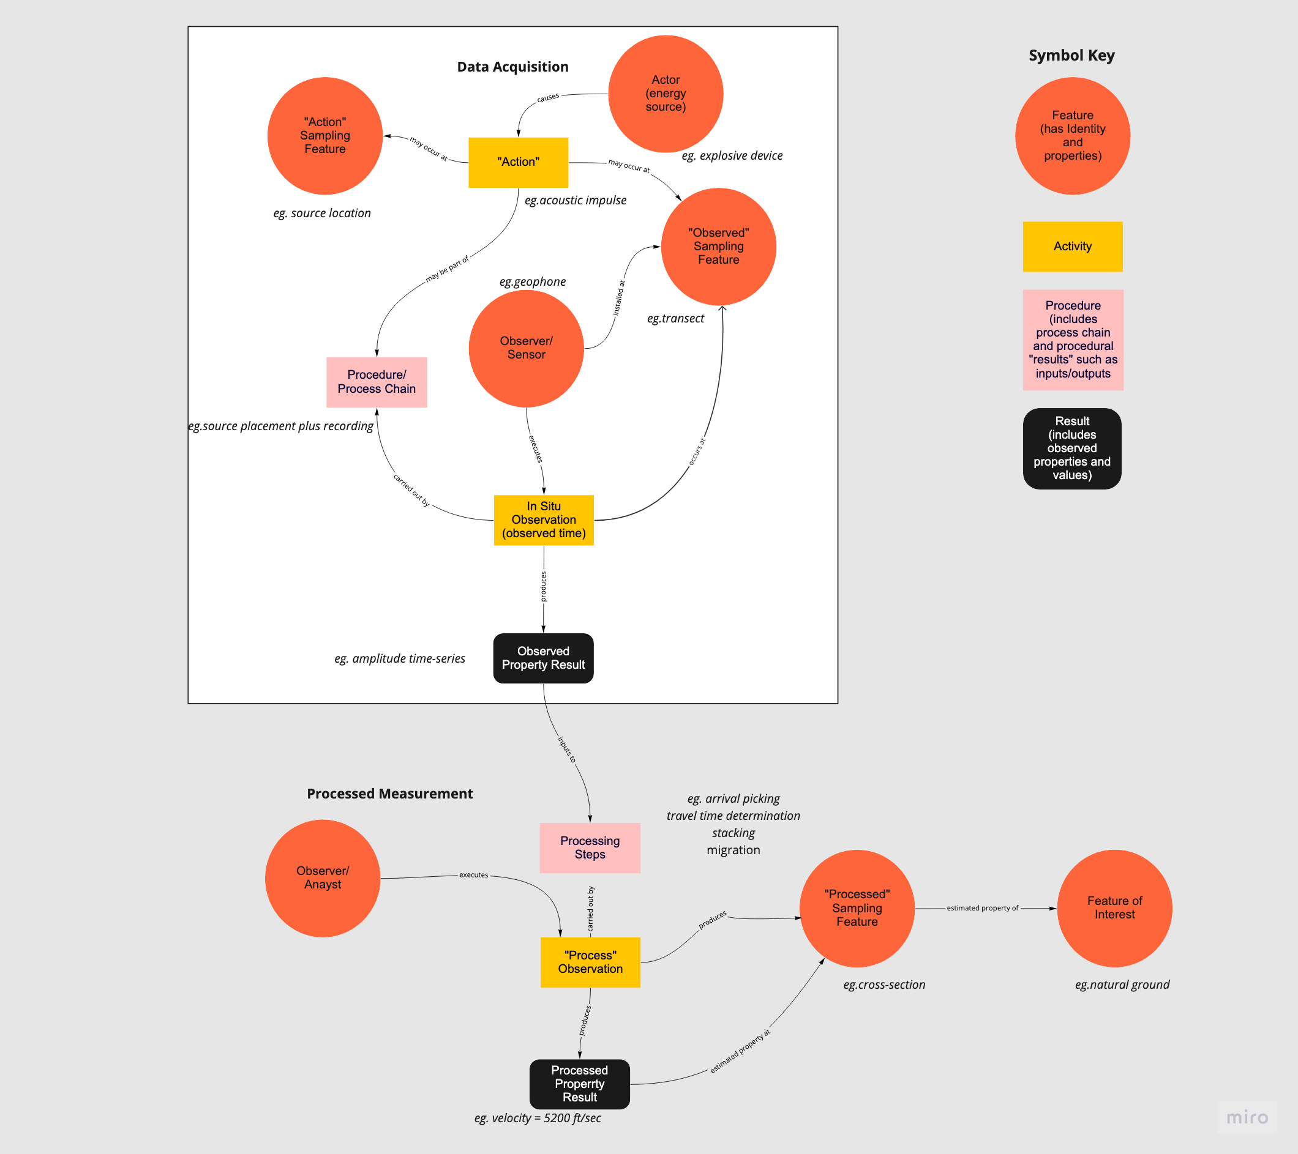
DIGGS Conceptual Model for Geophysics
Notes:
Conceptually, geophysical survey data requires two separate “measurement” constructs – one for the measurements obtained as part of the data acquisition, and a second for the measurement activity that produces the final “processed” result. The processed measurement construct is essentially identical to the existing DIGGS measurement except that the procedure component of a DIGGS measurement takes as input the results generated from data acquisition. Therefore, we can use the existing DIGGS measurement structure to carry processed geophysical survey results with some extensions to allow for linking processed measurements with data acquisition measurements through a new procedure type, and 2D and 3D geometry constructs for the geometries of processed results.
Data acquisition measurements requires building a new measurement object that will allow for associating the measurement procedure with multiple sensor readings and geometries, and including additional information on source locations relative to sensor readings.

Slide 7
How many specializations are needed?
One structure for every method/submethod?
Want to avoid if possible
Two major subdivisions?
Active vs. Passive Methods
Possible approach
Bin entire suite of considered methods into these two categories
Select 2-3 disparate methods in each group
Develop structure for each method
Merge commonalities to reduce number of structures.

Slide 8
Fundamental Question
How much of the “raw data” should be exposed explicitly in DIGGS xml, and what should be left to transfer via external files?
borehole log
electrical resistivity
frequency domain EM
gravity
ground penetrating radar
induced polarization
magnetotellurics
magnetometry
MASW - active
MASW - passive
nuclear magnetic resonance
radiometric
seismic reflection
seismic refraction
self potential
time-domain EM
very long frequency EM
wireline log

Slide 9
Objective 3
Develop metadata objects to support transfer of external large files
Are there ”standard” formats that can be referenced/supported
Can Seg-Y be used for universal binary transfer?

Slide 10
Objective 4
Develop appropriate compound spatial reference systems and structures to support spatial-temporal data domains
Domain of processed results so far is spatial only (eg. 1D, 2D or 3D coordinate reference systems where each axis is a spatial coordinate.
DIGGS currently defines compound CRS’s for 3D systems within a CRS dictionary
Eg. UTM Zone 11 plus NAVD88 (2D horizontal + vertical CRS)
For time-sections, users probably need to define these within an instance (can’t use a standard dictionary)
Time-volumes may be able to use defined systems if the 2D x-y coordinates are defined in standard 2D CRS’s.
What about frequency domain data?

Slide 13
Objective 5
Test geophysics schema extensions (processed data)primarily and modify if necessary
Develop instance documents and mappings for a number of techniques
Can we link to Vendor project for mapping of geophysical data to DIGGS?

Slide 14
Organizational Stuff
Meeting schedule/frequency
Full group efforts:
Property dictionary
Raw data schema objects
Subgroup efforts
External file handling (Caleb lead)
Compound coordinate systems (Dan lead)

